Slide 1
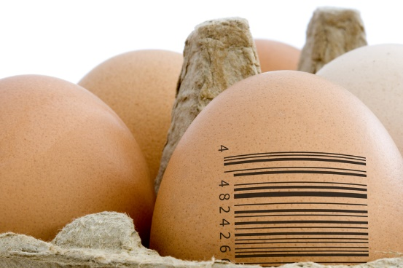
MODULE – 4
MODEL SELECTION
<Foliennummer>

Slide 2
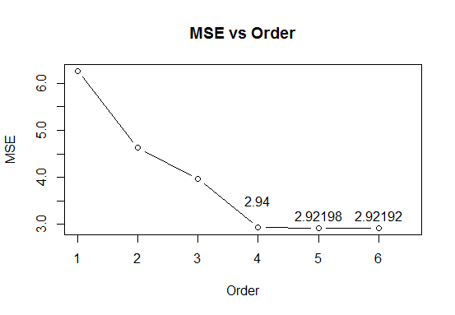
Model Evaluation
As the order of polynomial expansion increases, the MSE decrease. Even beyond fourth order on data we know comes from a fourth order polynomial!
Have we found a way to arbitrarily improve accuracy?
Notes:
<Foliennummer>

Slide 3
In Sample and Out of Sample Error
Have we found a way to arbitrarily improve accuracy?
No!
The MSE value is the MSE of the points in the data used to train our model. This is in-sample error.
We want to know how well the model performs on new data (”generalizes”). This is out-of-sample error.
Complex models can overfit – learning noise within the training data that permit them to achieve high in-sample performance but which makes them worse at generalizing.

Slide 4
Hold-out Validation
The best way to estimate how well a model performs on new data is to test it on new data.
Hold-out validation splits our labelled data into training data, which is used to fit the model, and test data, which is used to evaluate the model.
Data expensive
Computation cheap
Notes:
<Foliennummer>

Slide 5
Cross Validation (K-Folds)
Divide data into n subsets.
Generate n models, each using all but one subset.
Test each model on the hold-out subset.
Combine results.
The extreme case is called ’all-but-one validation’, where n is the size of the data set.
As n increases:
Data cheap
Computation expensive

Slide 6
Validation and Cross Validation in R
Often methods have the ability to specify cross-validation when you construct the model.
For glm models, you can use boot::cv.glm. Note that an OLS (lm) model is a glm model with Gaussian family ☺.
If neither of these cases pertain, you’ll need to write your own function.
<Foliennummer>
Notes:
<Foliennummer>

Slide 7
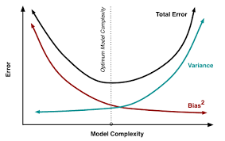
The bias-variance trade-off !!!
Our expected error over any data is composed of:
Randomness inherent in the system modeled.
Model Bias – from erroneous (typically simplifying) assumptions in the learning algorithm.
Model Variance – from sensitivity of the learning algorithms to small fluctuations in the training data.
Simple models will have high bias and low variance.
Sophisticated models will have low bias and high variance. The can fit more complex functions but can ’overfit’, adapting themselves to noise in the training data.
An initial measure of ’sophistication’: Free parameters – i.e. the number of coefficients being learnt.

Slide 8
Training, Evaluation & Test
Validation techniques provide an unbiased estimate of a given model.
BUT if we select the model to use from a set of candidates based on their performance on the validation data, this performance is a biased estimate for the selected model.
To get an unbiased estimate of the chosen model, an additional validation step is required.
Watch out for big drops in performance.
Common approaches:
3 way split: Training, Evaluation (Model Selection) and Test data
2 way split: Training and Evaluation using cross validation and Test data.
Notes:
<Foliennummer>

Slide 9
Model Validation/Selection Exercises
Split the poly4 data into training, evaluation and test sets.
Use a .5/.3/.2 split. Make sure to randomize indices.
Build the same models as in the regression exercise.
Evaluate the MSE of the models on the evaluation data. Select the best.
Evaluate the selected model's performance on the test data.
<Foliennummer>

Slide 10
Controlling Complexity: Regularization
Idea: Rather than remove variables to restrict model complexity, instead restrict their freedom to take on values.
L1 regularization – penalize absolute values of parameters.
L2 regularization – penalize square values of parameters.
L2 regularization shrinks parameters throughout the model, though concentrating on particular parameters. L1 will in many cases result with a sparse x, meaning that some values in x are exactly zero while others may be relatively large.
<Foliennummer>

Slide 11

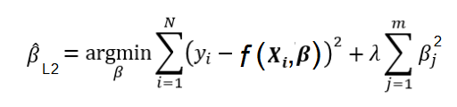
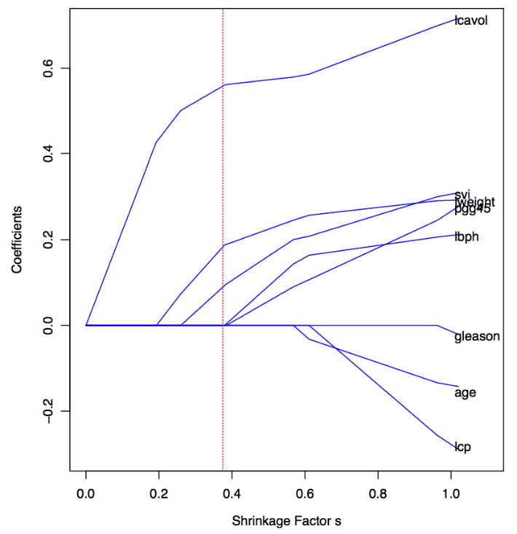
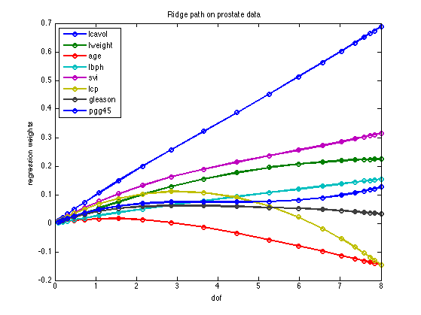
is a tuning parameter that governs the balance between error minimization and parameter regularization
L1
L2
Notes:
<Foliennummer>

Slide 12
Other common forms of regularization
Adding noise to training data
Early stopping – do not optimize completely (neural networks)
Drop-out – varying model during training (neural networks)
Notes:
<Foliennummer>

Slide 13
Regularization Exercises
Walk through regularization examples as a class:
Ridge regression
Neural network
Notice that hyper-parameter selection is model selection.
But too many models can lead to false positives...
<Foliennummer>

Slide 14
How to split your data
Do you have enough training data to obtain a high quality model?
Do you have enough validation data to distinguish performance of models?
Do you have enough test data to accurately estimate performance?
Notes:
<Foliennummer>

Slide 15
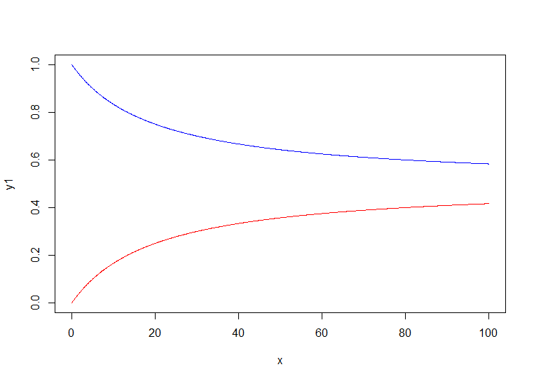
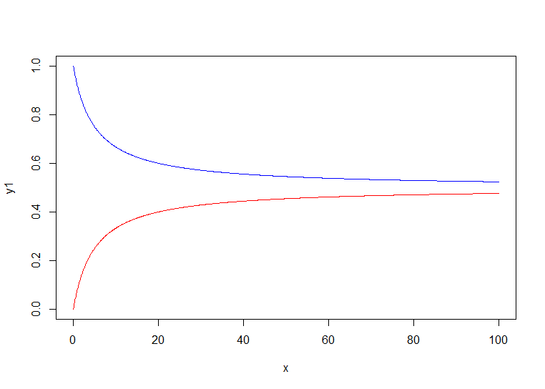
Learning Graphs
Validation/CV error approaches long run generalization error on number of training cases from above.
Training error approaches error on number of training cases from from below.
The amount of improvement that can be obtained from more data can be read from the difference in these two amount on a training graph.

Slide 16
Significant difference in model performance
Examine whether best model significantly out performs second best given validation data.
We test the probability that we would see the differences in (squared) residuals observed between two models if the true difference was 0.
Square residuals of both models
Subtract lower performing model from higher performing model
Perform one-sided t test on resulting vector
t.test(difference_vector,alternative="greater")
Conclude significance if p-value lower than desired threshold (.05, .01, .005, etc)
Notes:
<Foliennummer>

Slide 17
Evaluate accuracy of test performance
Pass (squared) residual vector to t.test and specify confidence level:
t.test(squared_residuals,conf.level=.995)
Notes:
<Foliennummer>

Slide 18
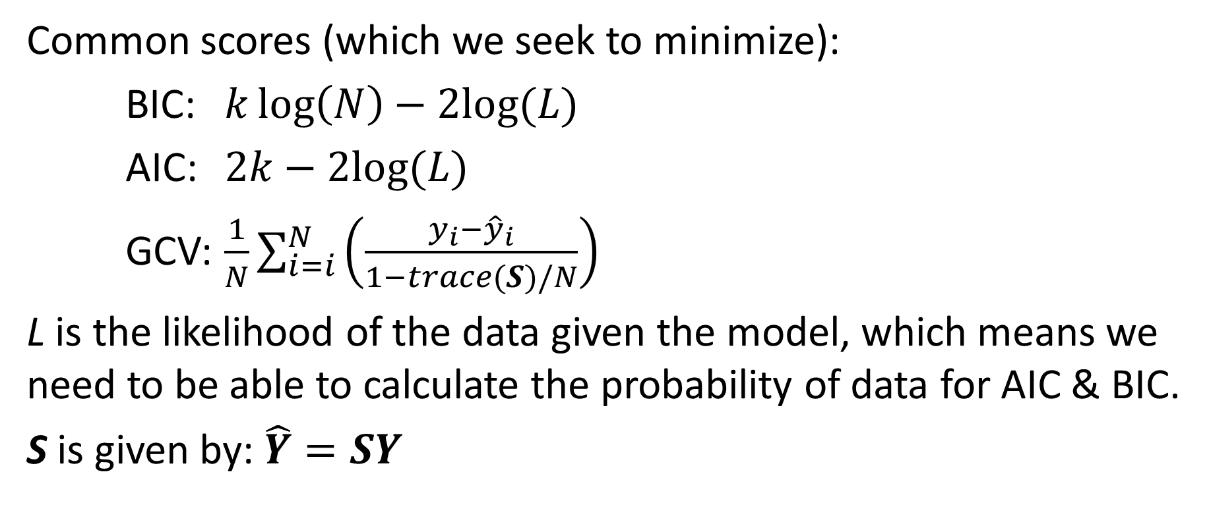

Statistical Model Evaluation: AIC, BIC and GCV
Common scores (which we seek to minimize):
BIC:
AIC:
GCV:
L is the likelihood of the data given the model, which means we need to be able to calculate the probability of data for AIC & BIC.
S is given by:
<Foliennummer>

Slide 19

Tests for Model Evaluation
We can compare the relative likelihood of different models.
Where we have k models, let their AIC or AICc score be: A1, A2, … Ak.
Let Amin be the minimum of these.
The relative likelihood of a model i is:
We can be comfortable that we have used enough data to evaluate relative models when this falls below some threshold for all i≠min.
Notes:
<Foliennummer>

